Slide 1

SDP End-term evaluation
AN IOT-BASED SYSTEM FOR REMOTE PATIENT MONITORING
Supervised By: Dr. Rakesh Ranjan Swain
Group No. : T1
Sreyojit Thakur (2041020008)
Soumya Ranjan Dakua (2041004003)
Kaustav Patra (2041016147)
Nikhil Kumar Agarwal (2041001029)
Department of Computer Sc. and Engineering
Faculty of Engineering & Technology (ITER)
Siksha ‘O’ Anusandhan (Deemed to be) University
Bhubaneswar, Odisha
1

Slide 2
PRESENTATION OUTLINE
Introduction
Overview
Motivation
Uniqueness of Proposed System
Literature Survey
Existing System
Problem Identification
Schematic Layout and Hardware Diagram
Methods And Algorithms Used
Experimentation and Results
System Specifications
Dataset Description
Experimental Outcomes
Result Analysis And Validation
Summary
Limitations of Proposed System
Future Scope of Proposed System
Conclusion
Bibliography
2

Slide 3
INTRODUCTION
OVERVIEW
An IoT-based system for remote patient monitoring is a technological solution designed to monitor patient’s health parameters.
This system typically incorporates various sensors and modules to collect health data about patient.
Wireless technologies such as Bluetooth and Wi-Fi are also used to transfer data to remote locations.
Protocols used for such transfer include MQTT, HTTP, CoAP and others.
This data transmitted securely to healthcare professionals enables them to deliver personalized care to patients.
Remote patient monitoring systems have revolutionized healthcare allowing to remotely monitor patient’s health data and provide remote healthcare.
3

Slide 4
INTRODUCTION Contd.
MOTIVATION
Elderly people usually have mobility issues that that prevents them from visiting hospital for frequent health check-ups.
This may lead to some diseases being unnoticed which later cause serious health complication.
In order to prevent such situation, we develop an IOT-based System that measures the basic health parameters of the body – Pulse Rate, SpO2 level and Body temperature.
This health data send to the hospital server to keep an health record every time the patient upload their current data.
Doctors can access this data to diagnose their patient condition.
The server sent notice via if the uploaded data exceed pre-defined threshold.
This system is also helpful for recently recovered patient to monitor after-recovery health.
4

Slide 5
INTRODUCTION Contd.
UNIQUENESS OF PROPOSED SYSTEM
Our proposed system is unique because it can be tailored and customized according to the needs of the patient.
It is also compact integrating all necessary features for basic health check-up.
We are also developing algorithms to classify the patient into risk level to ensure more attention and care to the needy.
The classifier demonstrated consistently high accuracy on both training and test datasets indicating strong predictive capabilities and effective generalization to unseen instances.
5

Slide 6
LITERATURE SURVEY
Table 1: Basic Information of Relevant Research Paper
Research Paper | Year Published | Authors | Key Points | Limitations
IoT-Based Remote Patient Monitoring System for Cardiac Arrhythmia Detection^{[1]} | 2019 | J. Anusha, G. B. Abirami | Prompt intervention in case of abnormalities. | Continuous connectivity may not be available in poor areas.
A Review on Internet of Things (IoT) in Healthcare^{[2]} | 2018 | H. R. Thosar, Yogesh D. Jadhav | Identifies key challenges and areas for future research and innovation. | Lack of in-depth analysis on specific remote patient monitoring systems.
An IoT-Based Real-Time Remote Health Monitoring System for Chronic Disease Patients^{[3]} | 2020 | Xin Zhang, Ruixue Ding | Tailored monitoring and intervention for elderly patients with chronic diseases. | Privacy and security concerns regarding the transmission of sensitive health data.
Internet of Things (IoT)-Based Remote Monitoring for Elderly Chronic Disease Patients^{[4]} | 2019 | Md Alam Bhuiyan, A. B. M. Al Islam | Efficient data analytics in deriving insights from collected health data. | Adoption barriers among elderly patients due to technological complexity.
6

Slide 7
LITERATURE SURVEY Contd.
EXISTING SYSTEM
Although existing large remote monitoring systems are accurate, they are costly.
Such complex systems can be challenging to operate for elderly patients or those with limited technical proficiency.
In low-resource areas, there is connectivity and internet-access issues.
PROBLEM IDENTIFICATION
Integration of various sensors and proper sequencing to capture sensor data.
Calibration of analog sensors to give more accurate results.
Interfacing with nodeMCU to send the data to the web-server.
Implementing machine learning and classification tools to classify patient data.
Limited Accessibility and coverage issues in rural areas due to limited access to internet.
7

Slide 8
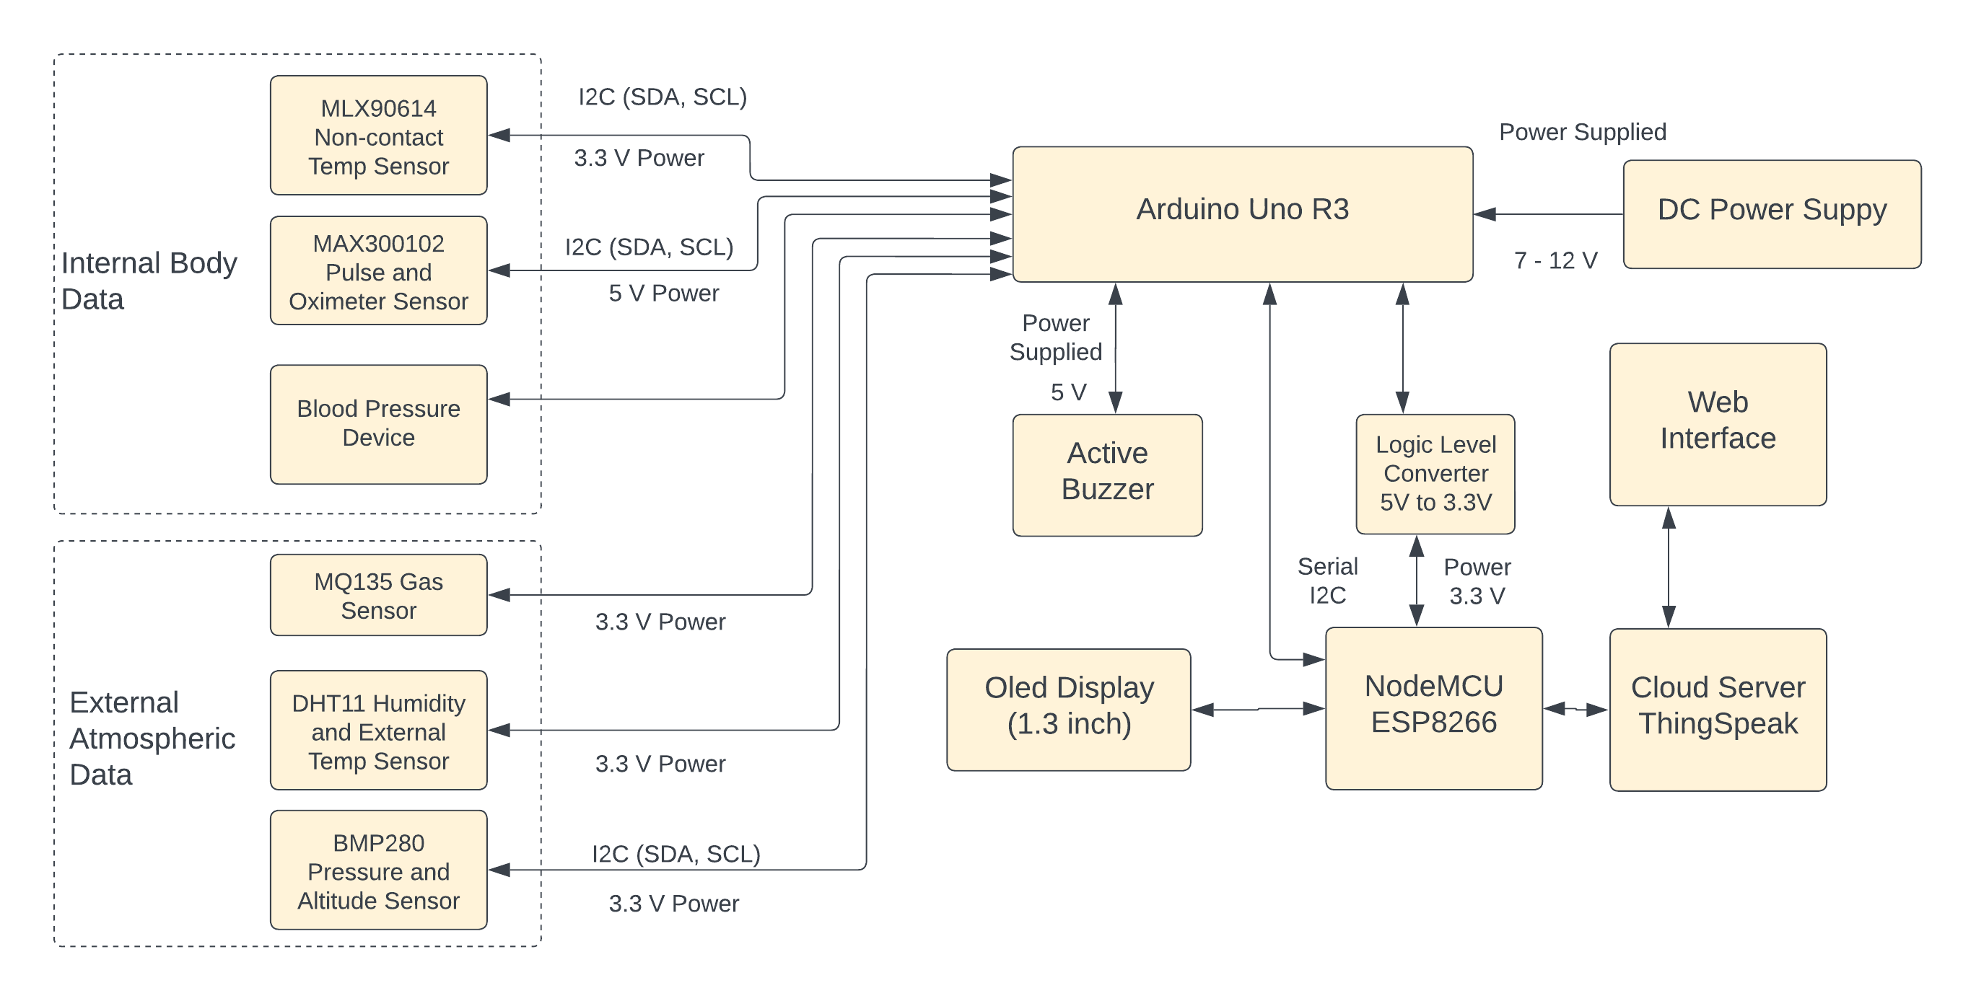
SCHEMATIC LAYOUT AND HARDWARE DIAGRAM
Fig. 1.1: Model Design Schematic Diagram
8

Slide 9
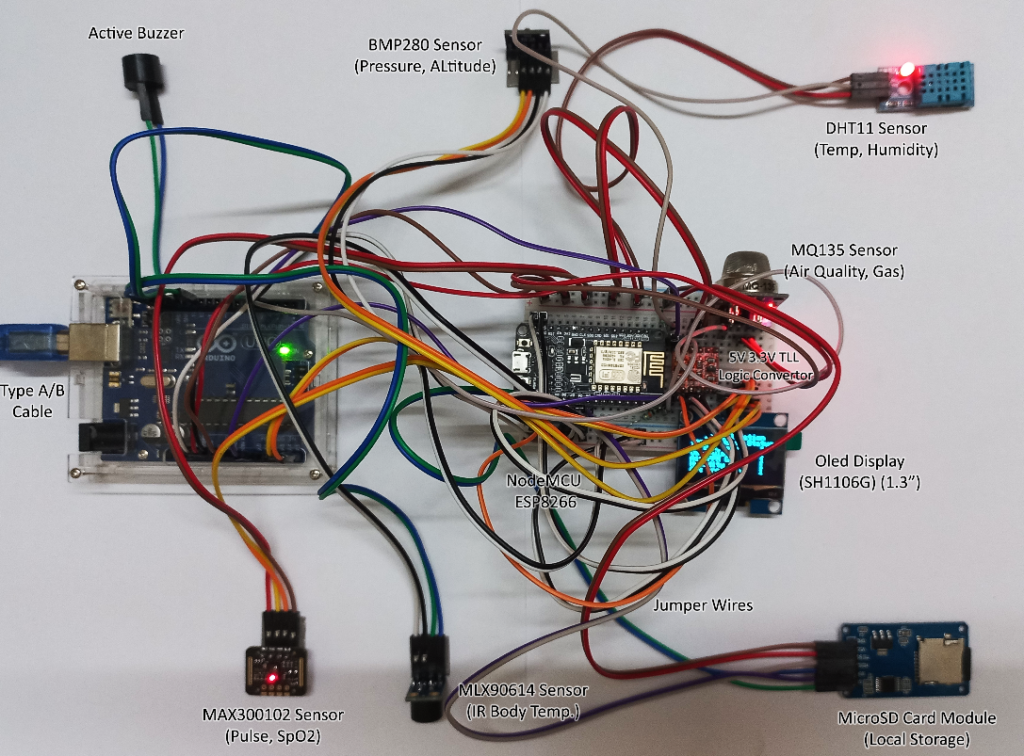
SCHEMATIC LAYOUT AND HARDWARE DIAGRAM Contd.
Fig. 1.2: Labelled Components of Hardware
9

Slide 10
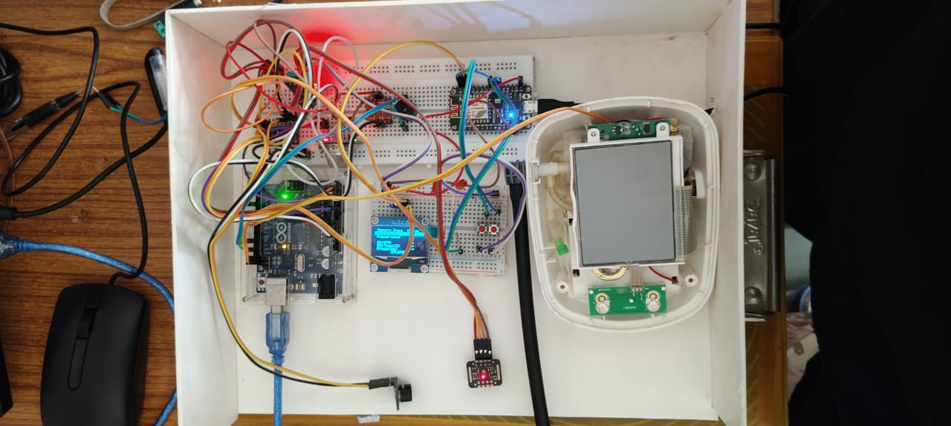
SCHEMATIC LAYOUT AND HARDWARE DIAGRAM Contd.
Fig. 1.3: Implemented Hardware Model
10

Slide 11
METHODS USED
STEPS FOR DATA COLLECTION, PROCESSING AND SENDING TO WEBPAGE
Step 1: Reading Data Through Sensors
The user input their data via the various sensors given which is measured and read by the microcontroller.
Step 2: Displaying the data
The microcontroller display each sensor data that is measured by the sensors for re-view of the user so that the user can decide if feels to re-input is need for any specific parameter. The data is displayed over led display.
Step 3: User Upload Confirmation
The user proceed to execute the upload process when the user feels the data is accurately measured.
Step 4: Sending Data to Web server
The nodeMCU interfaced with the microcontroller will send the data to the web server which will be displayed on the webpage.
Step 5: Classification of Patient Risk Level
The Web-server will classify the data of to give it a risk type – high, medium or low. In case of any current uploaded data exceeding predefined fatal threshold, a notification will be sent to email.
11

Slide 12
ALGORITHMS USED
RISK CLASSIFICATION ALGORITHM:
Step 1: Initialize Libraries and Model:
Import necessary libraries for data manipulation (pandas), scheduling tasks (schedule), time handling (time), machine learning model loading (joblib), and date-time operations (datetime).
Load the pre-trained Decision Tree Classifier model using joblib.
Step 2: Define Interval Assignment Functions:
Create functions to classify continuous health metrics (blood oxygen, body temperature, heart rate) into discrete intervals (Low, Medium, High).
Predict Risk Level Function:
Step 3: Define a function to predict the risk level based on health metrics.
Convert the raw metric values into categorical intervals using the previously defined functions.
Format the intervals as features for the classifier.
Use the pre-trained model to predict the risk level.
12

Slide 13
ALGORITHMS USED Contd.
Process New Patient Data:
Step 4: Define a function to process new patient data.
Create a list of dictionaries containing new patient health metrics.
For each patient's data, predict their risk level using the prediction function.
Append each patient’s data along with the predicted risk level and a timestamp to a new list.
Convert the list into a pandas DataFrame and print it.
Step 5: Schedule the Data Processing Task:
Schedule the data processing function to execute every 3 hours using the schedule library.
Step 6:Run the Scheduler in a Continuous Loop:
Continuously check for and execute scheduled tasks using an infinite loop.
Sleep for 1 second between checks to prevent excessive CPU usage.
13

Slide 14
ALGORITHMS USED Contd.
INPUT PARAMETERS:
Body Temperature (in Celsius)
SpO2 Level or Oxygen Saturation level in blood (in %)
Pulse Rate or Heart Rate (in bpm)
TARGET CATEGORY (RISK TYPE):
Low-Risk Level
Medium-Risk Level
High-Risk Level
MODEL ACCURACY AND VALIDATION:
Precision: It measures how often an ML model is correct when predicting the target class.
Recall: It measures whether an ML model can find all objects of the target class.
Accuracy: It measures how often a classification ML model is correct overall.
F1 Score: a machine learning evaluation metric that measures a model's accuracy
14

Slide 15
EXPERIMENTATION AND RESULTS
SYSTEM SPECIFICATIONS
Microcontroller:
Arduino Uno Rev3
NodeMCU ESP8266
Body Sensors:
MAX300102 Pulse and Oximeter Sensor
MQ135 Gas Sensor
MLX90614 Non-contact Temperature Sensor
Blood Pressure Device
DHT11 Humidity and External Temp Sensor
OLED Display (SH110x 1.3 inch)
BMP280 Pressure and Altitude Sensor
5 V Active Buzzer
15

Slide 16
EXPERIMENTATION AND RESULTS Contd.
DATASET DESCRIPTIONS
This dataset contains vital sign measurements for patients, including blood oxygen levels, body temperature, and heart rate.
The dataset was collected from a hospital database during routine patient monitoring. Each row represents a patient, and the columns include the following parameters:
Body Temperature (°C): Body temperature of the patient in degrees Celsius.
Blood Oxygen Saturation Level (%): Percentage of dissolved oxygen saturation in the patient’s blood.
Heart Pulse Rate (bpm): Pulse rate of the patient in beats per minute.
The dataset upon which the ML model is trained is in CSV file format with 100000 records and 3 fields, each column represent the corresponding parameter.
The target variable is “Risk Level”, which indicates the patient's risk category - high, medium, or low. This is used to train machine the regression models for classification tasks, such as identifying patients at high risk for adverse health events based on their vital signs.
16

Slide 17
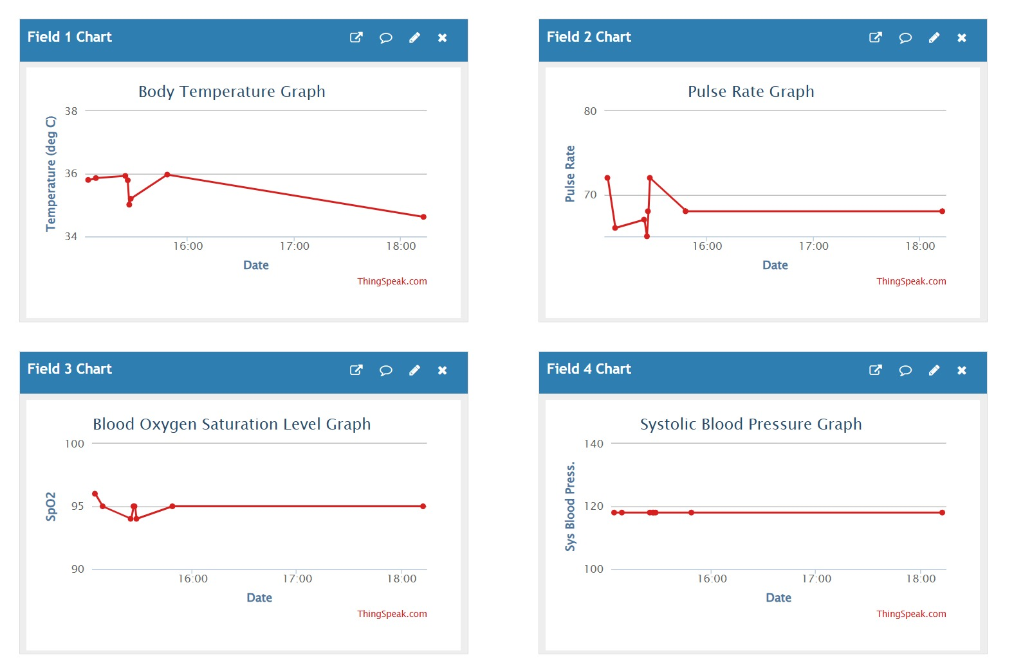
EXPERIMENTATION AND RESULTS Contd.
EXPERIMENTAL OUTCOMES
Fig. 1.5: ThingSpeak Data Visualization (Field 1 to Field 4)
17

Slide 18
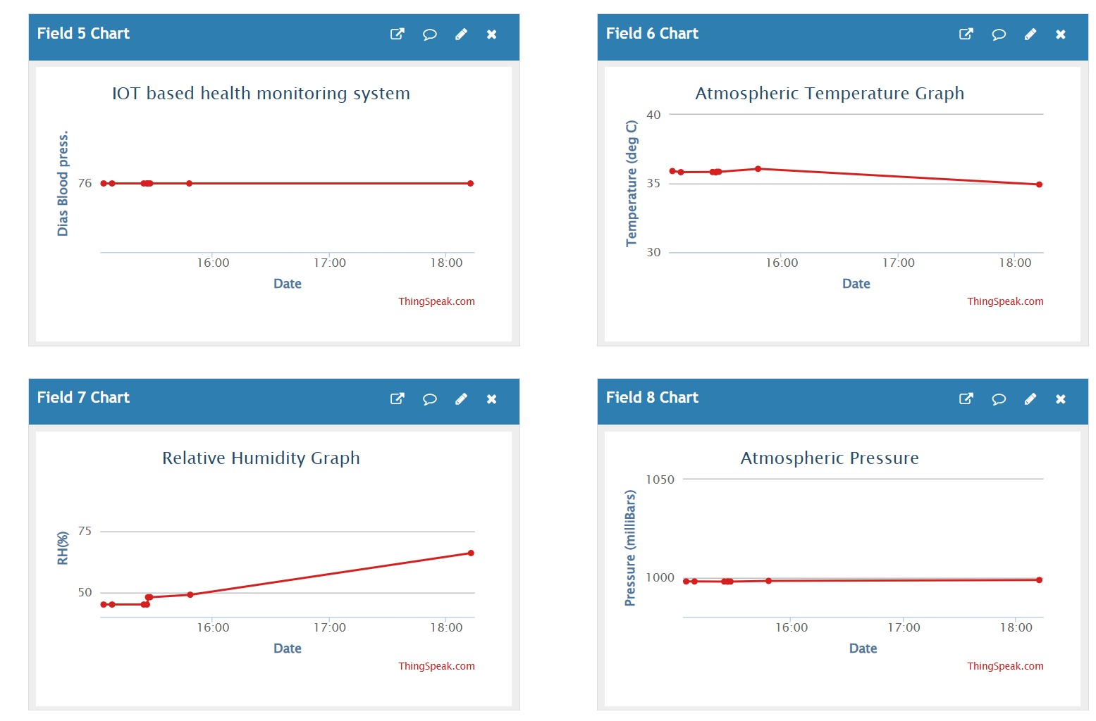
EXPERIMENTATION AND RESULTS Contd.
EXPERIMENTAL OUTCOMES
Fig. 1.5: ThingSpeak Data Visualization (Field 5 to Field 8)
18

Slide 19
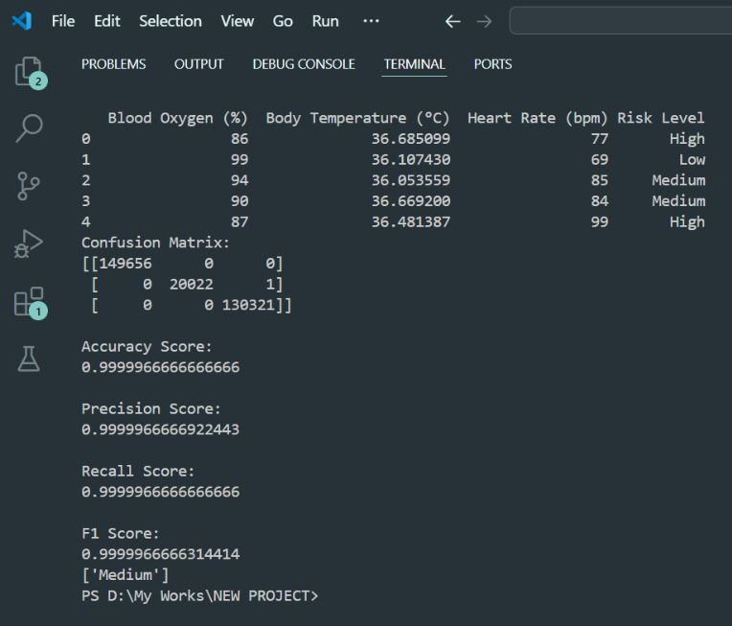
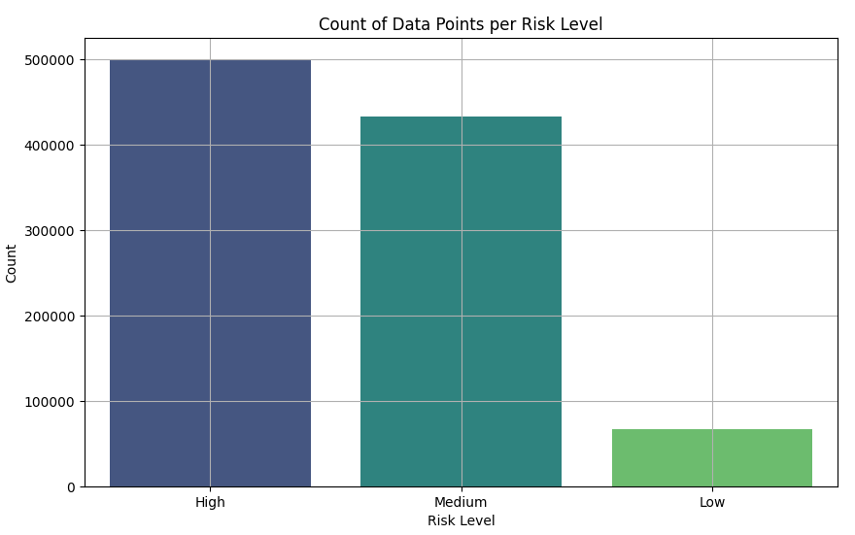
EXPERIMENTATION AND RESULTS Contd.
RESULT ANALYSIS AND VALIDATION
Table 2: Classification ML Model Metrics
Sl. No. | ML Metrics | Values
1 | Precision | 0.9999966666922443
2 | Recall | 0.9999966666666666
3 | Accuracy | 0.9999966666666666
4 | F1 Score | 0.9999966666314414
Fig. 1.4: ML Metrics Screenshot
Fig. 1.5: ML Model Data Testing Set Result
19

Slide 20
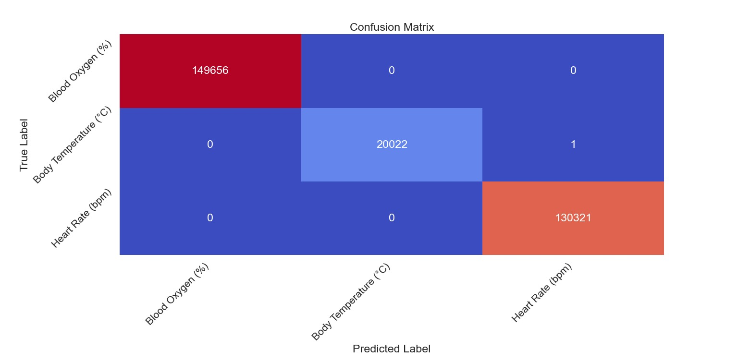
EXPERIMENTATION AND RESULTS Contd.
RESULT ANALYSIS AND VALIDATION
Fig. 1.6: Confusion Matrix of Implemented ML Model
20

Slide 21
EXPERIMENTATION AND RESULTS Contd.
RESULT ANALYSIS AND VALIDATION
Table 3: Risk Classification of Patient Record
Category ID | Risk Type | Description
0 | Low Risk | Not anywhere near threshold. Stable data over the various parameters. Environment condition and quality is good for the elderly.
1 | Medium Risk | Close to threshold or crossed it slightly. Fluctuation in data over the various parameters. Environment condition will not cause complication for the elderly. In case of recent data significantly worse than previous, email send to the doctor.
2 | High Risk | Crossed threshold by a large margin slightly. Always constant and high in data over the various parameters. Environment condition may cause complication for the elderly. In case of recent data minorly worse than previous, email send to the doctor and the registered guardian of the patient.
21

Slide 22
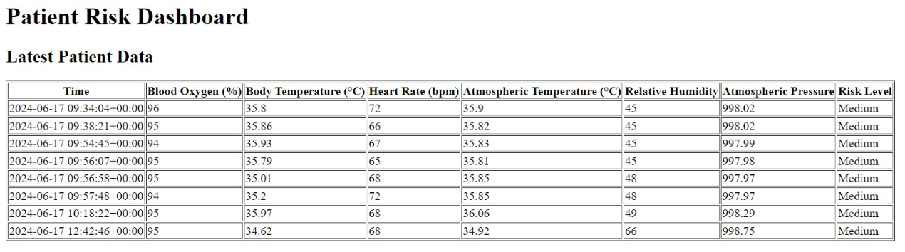
EXPERIMENTATION AND RESULTS Contd.
RESULT ANALYSIS AND VALIDATION
Fig. 1.7: Real-time Data Risk-Type Classification Result
22

Slide 23
SUMMARY
LIMITATIONS OF PROPOSED SYSTEM
Our system requires a certain level of technical expertise to set up and maintain, which may limit its adoption by non-technical users.
The accuracy and performance of the system may be affected by external factors such as magnetic interference and network failures.
The system is not yet fully tested physically in public therefore feedback for comfortability and acceptance is unknown.
FUTURE SCOPE OF PROPOSED SYSTEM
In future if the module gets disconnected from internet then we will store the data in a SD card for future monitoring.
More functionalities and hardware can be added to make it automated and integrated to a hospital management system so that real-time data is extracted and processed by AI to predict disease.
We also aim to improve the hardware parts according to the public need.
23

Slide 24
SUMMARY
In future if the module gets disconnected from internet then we will store the data in a SD card for future monitoring.
We plan to make the device more user-friendly for the elderly people and also to a wider audience, including non-technical users.
24

Slide 25
CONCLUSION
IoT-based remote patient monitoring systems have the potential to revolutionize healthcare by:
Enhancing patient
careImproving accessibilityReducing costsChallenges related to these systems include:Data securityTechnical reliabilitySystem integrationOngoing advancements in technology and infrastructure are addressing these challenges.As the healthcare industry embraces digital transformation, IoT-based RPM systems will:Play a crucial role in shaping the future of patient careLead to a more efficient, effective, and patient-centered healthcare ecosystem.
25

Slide 26
BIBLIOGRAPHY
J. Anusha, G. B. Abirami, et al. "IoT-Based Remote Patient Monitoring System for Cardiac Arrhythmia Detection," 2019 IEEE International Conference on Electrical, Computer and Communication Technologies (ICECCT).
Harshavardhan R. Thosar, Yogesh D. Jadhav, et al. "A Review on Internet of Things (IoT) in Healthcare," Procedia Computer Science, 2018.
Xin Zhang, Ruixue Ding, et al. "An IoT-Based Real-Time Remote Health Monitoring System for Chronic Disease Patients," IEEE Internet of Things Journal, 2020.
Md Zakirul Alam Bhuiyan, A. B. M. Alim Al Islam, et al. "Internet of Things (IoT)-Based Remote Monitoring for Elderly Chronic Disease Patients," IEEE Access, 2019.
26

Slide 27

27

